Slide 1
Chapter 8
Design Concepts
Slide Set to accompany
Software Engineering: A Practitioner’s Approach, 7/e
by Roger S. Pressman
Slides copyright © 1996, 2001, 2005, 2009 by Roger S. Pressman
For non-profit educational use only
May be reproduced ONLY for student use at the university level when used in conjunction with Software Engineering: A Practitioner's Approach, 7/e. Any other reproduction or use is prohibited without the express written permission of the author.
All copyright information MUST appear if these slides are posted on a website for student use.
These slides are designed to accompany Software Engineering: A Practitioner’s Approach, 7/e (McGraw-Hill, 2009) Slides copyright 2009 by Roger Pressman.

Slide 2
Design
The Roman architecture critic Vitruvius advanced the notion that well-designed buildings
were those which exhibited firmness, commodity, and delight Mitch Kapor, the creator of Lotus 1-2-3, presented a “software design manifesto” in Dr. Dobbs Journal. He said:
  Good software design should exhibit:
  Firmness: A program should not have any bugs that inhibit its function.
  Commodity: A program should be suitable for the purposes for which it was intended.
  Delight: The experience of using the program should be pleasurable one.
These slides are designed to accompany Software Engineering: A Practitioner’s Approach, 7/e (McGraw-Hill, 2009) Slides copyright 2009 by Roger Pressman.

Slide 3
Coding is (generally) low level. E.g. you have to write for(i = ...) and so on.
Design is high level. You want your program to do something again and again.
You want to create a model or representation
These slides are designed to accompany Software Engineering: A Practitioner’s Approach, 7/e (McGraw-Hill, 2009) Slides copyright 2009 by Roger Pressman.

Slide 4
Each of the elements of the requirements model provides information that is necessary to create the four design models required for a complete specification of design.
The flow of information during software design is illustrated in Figure 8.1. (Next slide)
These slides are designed to accompany Software Engineering: A Practitioner’s Approach, 7/e (McGraw-Hill, 2009) Slides copyright 2009 by Roger Pressman.

Slide 5
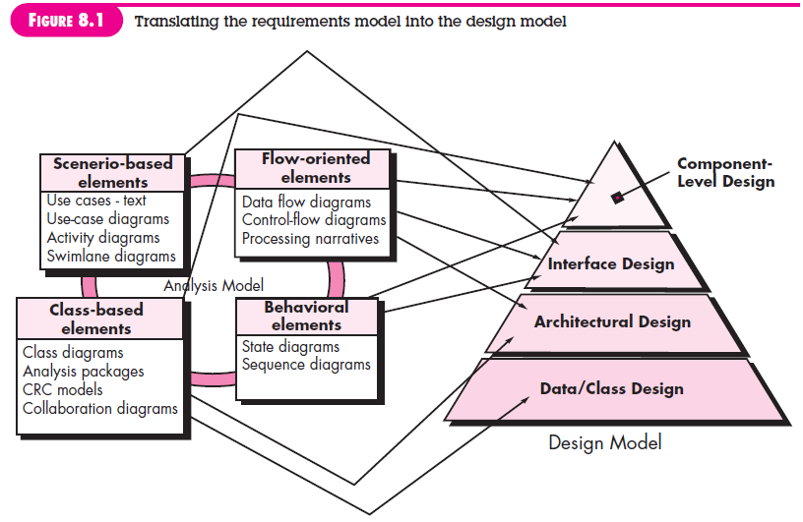
Analysis Model -> Design Model
These slides are designed to accompany Software Engineering: A Practitioner’s Approach, 7/e (McGraw-Hill, 2009) Slides copyright 2009 by Roger Pressman.

Slide 6
The requirement model feeds the design task.
Design produces a data/class design, an architectural design, an interface design, and a component design.
E.g. The interface design describes how the software communicates with systems that interoperate with it, and with humans who use it.
These slides are designed to accompany Software Engineering: A Practitioner’s Approach, 7/e (McGraw-Hill, 2009) Slides copyright 2009 by Roger Pressman.

Slide 7
Design and Quality
Three characteristics that serve as a guide for the evaluation of a good design:
the design must implement all of the explicit requirements contained in the analysis model, and it must accommodate all of the implicit requirements desired by the customer.
the design must be a readable, understandable guide for those who generate code and for those who test and subsequently support the software.
the design should provide a complete picture of the software, addressing the data, functional, and behavioral domains from an implementation perspective.
These slides are designed to accompany Software Engineering: A Practitioner’s Approach, 7/e (McGraw-Hill, 2009) Slides copyright 2009 by Roger Pressman.

Slide 8
Quality Guidelines
How to evaluate a design? Use the following guidelines:
A design should exhibit an architecture that (1) has been created using recognizable architectural styles or patterns, (2) is composed of components that exhibit good design characteristics and (3) can be implemented in an evolutionary fashion
  For smaller systems, design can sometimes be developed linearly.
A design should be modular; that is, the software should be logically partitioned into elements or subsystems
A design should contain distinct representations of data, architecture, interfaces, and components.
A design should lead to data structures that are appropriate for the classes to be implemented and are drawn from recognizable data patterns.
A design should lead to components that exhibit independent functional characteristics.
A design should lead to interfaces that reduce the complexity of connections between components and with the external environment.
A design should be derived using a repeatable method that is driven by information obtained during software requirements analysis.
A design should be represented using a notation that effectively communicates its meaning.
These slides are designed to accompany Software Engineering: A Practitioner’s Approach, 7/e (McGraw-Hill, 2009) Slides copyright 2009 by Roger Pressman.

Slide 9
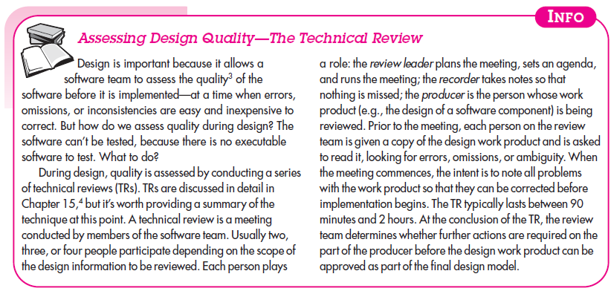
These slides are designed to accompany Software Engineering: A Practitioner’s Approach, 7/e (McGraw-Hill, 2009) Slides copyright 2009 by Roger Pressman.

Slide 10
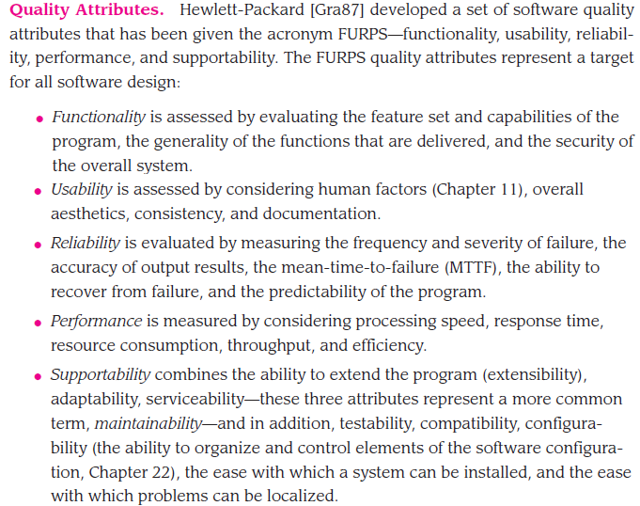
These slides are designed to accompany Software Engineering: A Practitioner’s Approach, 7/e (McGraw-Hill, 2009) Slides copyright 2009 by Roger Pressman.

Slide 11
Not every software quality attribute is weighted equally as the software design is developed.
One application may stress functionality with a special emphasis on security.
Another may demand performance with particular emphasis on processing speed, etc.
These slides are designed to accompany Software Engineering: A Practitioner’s Approach, 7/e (McGraw-Hill, 2009) Slides copyright 2009 by Roger Pressman.

Slide 12
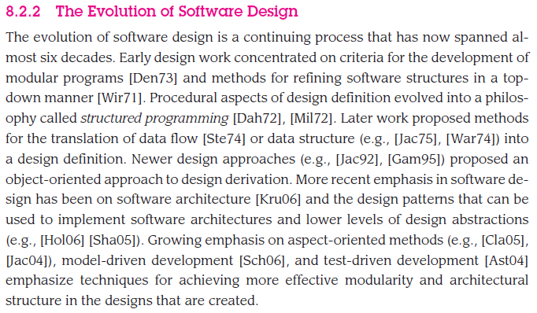
These slides are designed to accompany Software Engineering: A Practitioner’s Approach, 7/e (McGraw-Hill, 2009) Slides copyright 2009 by Roger Pressman.

Slide 13
Helps you answer the following questions:
• What criteria can be used to partition software into individual components? (E.g. OOP -> data and objects that are needed together, Aspect OP -> Based on cross-cutting concerns (feature or behavior).
• How is function or data structure detail separated from a conceptual representation of the software?
• What uniform criteria define the technical quality of a software design?
These slides are designed to accompany Software Engineering: A Practitioner’s Approach, 7/e (McGraw-Hill, 2009) Slides copyright 2009 by Roger Pressman.

Slide 14
Design Principles
The design process should not suffer from ‘tunnel vision.’
The design should be traceable to the analysis model.
The design should not reinvent the wheel.
The design should “minimize the intellectual distance” [DAV95] between the software and the problem as it exists in the real world.
The design should exhibit uniformity and integration.
The design should be structured to accommodate change.
The design should be structured to degrade gently, even when aberrant data, events, or operating conditions are encountered.
Design is not coding, coding is not design.
The design should be assessed for quality as it is being created, not after the fact.
The design should be reviewed to minimize conceptual (semantic) errors.
From Davis [DAV95]
These slides are designed to accompany Software Engineering: A Practitioner’s Approach, 7/e (McGraw-Hill, 2009) Slides copyright 2009 by Roger Pressman.

Slide 15
Fundamental Concepts
Abstraction—data, procedure, control
Architecture—the overall structure of the software
Patterns—”conveys the essence” of a proven design solution
Separation of concerns—any complex problem can be more easily handled if it is subdivided into pieces
Modularity—compartmentalization of data and function
Hiding—controlled interfaces
Functional independence—single-minded function and low coupling
Refinement—elaboration of detail for all abstractions
Aspects—a mechanism for understanding how global requirements affect design
Refactoring—a reorganization technique that simplifies the design
OO design concepts—Appendix II
Design Classes—provide design detail that will enable analysis classes to be implemented
These slides are designed to accompany Software Engineering: A Practitioner’s Approach, 7/e (McGraw-Hill, 2009) Slides copyright 2009 by Roger Pressman.

Slide 16
Data Abstraction
A data abstraction is a named collection of data that describes a data object. In the context of the procedural abstraction open, we can define a data abstraction called door. Like any data object, the data abstraction for door would encompass a set of attributes that describe the door (e.g., door type, swing direction, opening mechanism, weight, dimensions).
These slides are designed to accompany Software Engineering: A Practitioner’s Approach, 7/e (McGraw-Hill, 2009) Slides copyright 2009 by Roger Pressman.

Slide 17
Data Abstraction
door
manufacturer
model number
type
swing direction
inserts
lights
type
number
weight
opening mechanism
implemented as a data structure
These slides are designed to accompany Software Engineering: A Practitioner’s Approach, 7/e (McGraw-Hill, 2009) Slides copyright 2009 by Roger Pressman.

Slide 18
Procedural Abstraction
A procedural abstraction refers to a sequence of instructions that have a specific and limited function. The name of a procedural abstraction implies these functions, but specific details are suppressed. An example of a procedural abstraction would be the word open for a door. Open implies a long sequence of procedural steps (e.g., walk to the door, reach out and grasp knob, turn knob and pull door, step away from moving door, etc.)
These slides are designed to accompany Software Engineering: A Practitioner’s Approach, 7/e (McGraw-Hill, 2009) Slides copyright 2009 by Roger Pressman.

Slide 19
Procedural Abstraction
open
details of enter
algorithm
implemented with a "knowledge" of the
object that is associated with enter
These slides are designed to accompany Software Engineering: A Practitioner’s Approach, 7/e (McGraw-Hill, 2009) Slides copyright 2009 by Roger Pressman.

Slide 20
Architecture
“The overall structure of the software and the ways in which that structure provides conceptual integrity for a system.” [SHA95a]
Components, their structures, their interaction.
Systems (or subsystems), their structures, their interactions.
These slides are designed to accompany Software Engineering: A Practitioner’s Approach, 7/e (McGraw-Hill, 2009) Slides copyright 2009 by Roger Pressman.

Slide 21
Architecture
Structural properties. This aspect of the architectural design representation defines the components of a system (e.g., modules, objects, filters) and the manner in which those components are packaged and interact with one another. For example, objects are packaged to encapsulate both data and the processing that manipulates the data and interact via the invocation of methods
Extra-functional properties. The architectural design description should address how the design architecture achieves requirements for performance, capacity, reliability, security, adaptability, and other system characteristics.
Families of related systems. The architectural design should draw upon repeatable patterns that are commonly encountered in the design of families of similar systems. In essence, the design should have the ability to reuse architectural building blocks.
These slides are designed to accompany Software Engineering: A Practitioner’s Approach, 7/e (McGraw-Hill, 2009) Slides copyright 2009 by Roger Pressman.

Slide 22
Dynamic models address the behavioral aspects of the program architecture, indicating how the structure or system configuration may change as a function of external events.
Process models focus on the design of the business or technical process that the system must accommodate.
Functional models can be used to represent the functional hierarchy of a system.
These slides are designed to accompany Software Engineering: A Practitioner’s Approach, 7/e (McGraw-Hill, 2009) Slides copyright 2009 by Roger Pressman.

Slide 23
Patterns
“A proven solution to a recurring problem within a certain context amidst competing concerns”
Design Pattern Template
Pattern name—describes the essence of the pattern in a short but expressive name
Intent—describes the pattern and what it does
Also-known-as—lists any synonyms for the pattern
Motivation—provides an example of the problem
Applicability—notes specific design situations in which the pattern is applicable
Structure—describes the classes that are required to implement the pattern
Participants—describes the responsibilities of the classes that are required to implement the pattern
Collaborations—describes how the participants collaborate to carry out their responsibilities
Consequences—describes the “design forces” that affect the pattern and the potential trade-offs that must be considered when the pattern is implemented
Related patterns—cross-references related design patterns
These slides are designed to accompany Software Engineering: A Practitioner’s Approach, 7/e (McGraw-Hill, 2009) Slides copyright 2009 by Roger Pressman.

Slide 24
Separation of Concerns
Any complex problem can be more easily handled if it is subdivided into pieces that can each be solved and/or optimized independently
A concern is a feature or behavior that is specified as part of the requirements model for the software
By separating concerns into smaller, and therefore more manageable pieces, a problem takes less effort and time to solve.
P1 is harder to solve than P2. Which one to solve first?
P1+P2 may be harder to solve together than one by one.
These slides are designed to accompany Software Engineering: A Practitioner’s Approach, 7/e (McGraw-Hill, 2009) Slides copyright 2009 by Roger Pressman.

Slide 25
Modularity
"modularity is the single attribute of software that allows a program to be intellectually manageable" [Mye78].
Monolithic software (i.e., a large program composed of a single module) cannot be easily grasped by a software engineer.
  The number of control paths, span of reference, number of variables, and overall complexity would make understanding close to impossible.
In almost all instances, you should break the design into many modules, hoping to make understanding easier and as a consequence, reduce the cost required to build the software.
These slides are designed to accompany Software Engineering: A Practitioner’s Approach, 7/e (McGraw-Hill, 2009) Slides copyright 2009 by Roger Pressman.

Slide 26
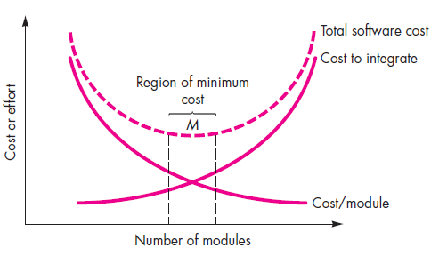
These slides are designed to accompany Software Engineering: A Practitioner’s Approach, 7/e (McGraw-Hill, 2009) Slides copyright 2009 by Roger Pressman.

Slide 27
Modularity: Trade-offs
What is the "right" number of modules
for a specific software design?
module development cost
cost of
software
module
integration
cost
optimal number
number of modules
of modules
These slides are designed to accompany Software Engineering: A Practitioner’s Approach, 7/e (McGraw-Hill, 2009) Slides copyright 2009 by Roger Pressman.

Slide 28
Information Hiding
module
• algorithm
controlled
interface
• data structure
• details of external interface
• resource allocation policy
clients
"secret"
a specific design decision
These slides are designed to accompany Software Engineering: A Practitioner’s Approach, 7/e (McGraw-Hill, 2009) Slides copyright 2009 by Roger Pressman.

Slide 29
Why Information Hiding?
reduces the likelihood of “side effects”
limits the global impact of local design decisions
emphasizes communication through controlled interfaces
discourages the use of global data
leads to encapsulation—an attribute of high quality design
results in higher quality software
These slides are designed to accompany Software Engineering: A Practitioner’s Approach, 7/e (McGraw-Hill, 2009) Slides copyright 2009 by Roger Pressman.

Slide 30
Functional Independence
Functional independence is achieved by developing modules with "single-minded" function and an "aversion" to excessive interaction with other modules.
Cohesion is an indication of the relative functional strength of a module.
  A cohesive module performs a single task, requiring little interaction with other components in other parts of a program. Stated simply, a cohesive module should (ideally) do just one thing.
Coupling is an indication of the relative interdependence among modules.
  Coupling depends on the interface complexity between modules, the point at which entry or reference is made to a module, and what data pass across the interface.
These slides are designed to accompany Software Engineering: A Practitioner’s Approach, 7/e (McGraw-Hill, 2009) Slides copyright 2009 by Roger Pressman.

Slide 31
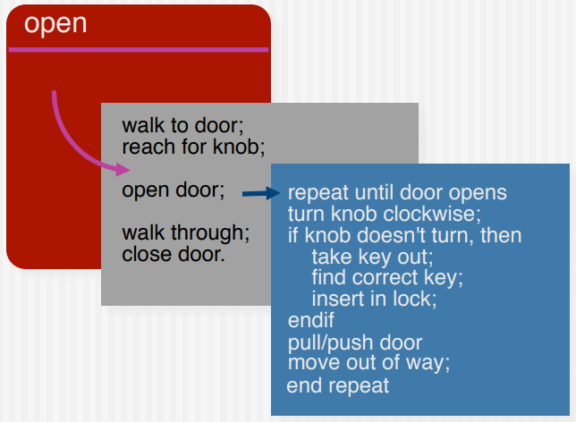
Stepwise Refinement
These slides are designed to accompany Software Engineering: A Practitioner’s Approach, 7/e (McGraw-Hill, 2009) Slides copyright 2009 by Roger Pressman.

Slide 32
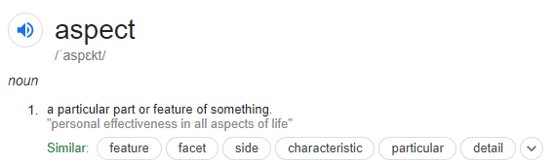
Aspect
These slides are designed to accompany Software Engineering: A Practitioner’s Approach, 7/e (McGraw-Hill, 2009) Slides copyright 2009 by Roger Pressman.

Slide 33
Aspects
Consider two requirements, A and B. Requirement A crosscuts requirement B “if a software decomposition [refinement] has been chosen in which B cannot be satisfied without taking A into account. [Ros04]
An aspect is a representation of a cross-cutting concern.
These slides are designed to accompany Software Engineering: A Practitioner’s Approach, 7/e (McGraw-Hill, 2009) Slides copyright 2009 by Roger Pressman.

Slide 34
Aspects—An Example
Consider two requirements for the SafeHomeAssured.com WebApp. Requirement A is described via the use-case Access camera surveillance via the Internet. A design refinement would focus on those modules that would enable a registered user to access video from cameras placed throughout a space. Requirement B is a generic security requirement that states that a registered user must be validated prior to using SafeHomeAssured.com. This requirement is applicable for all functions that are available to registered SafeHome users. As design refinement occurs, A* is a design representation for requirement A and B* is a design representation for requirement B. Therefore, A* and B* are representations of concerns, and B* cross-cuts A*.
An aspect is a representation of a cross-cutting concern. Therefore, the design representation, B*, of the requirement, a registered user must be validated prior to using SafeHomeAssured.com, is an aspect of the SafeHome WebApp.
These slides are designed to accompany Software Engineering: A Practitioner’s Approach, 7/e (McGraw-Hill, 2009) Slides copyright 2009 by Roger Pressman.

Slide 35
Two intuitive examples of cross-cutting concerns are Security and Logging
In an ideal context, an aspect is implemented as a separate module (component) rather than as software fragments that are “scattered” or “tangled” throughout many components.
To accomplish this, the design architecture should support a mechanism for defining an aspect—a module that enables the concern to be implemented across all other concerns that it crosscuts.
These slides are designed to accompany Software Engineering: A Practitioner’s Approach, 7/e (McGraw-Hill, 2009) Slides copyright 2009 by Roger Pressman.

Slide 36
Refactoring
Fowler [FOW99] defines refactoring in the following manner:
  "Refactoring is the process of changing a software system in such a way that it does not alter the external behavior of the code [design] yet improves its internal structure.”
When software is refactored, the existing design is examined for
  redundancy
  unused design elements
  inefficient or unnecessary algorithms
  poorly constructed or inappropriate data structures
  or any other design failure that can be corrected to yield a better design.
These slides are designed to accompany Software Engineering: A Practitioner’s Approach, 7/e (McGraw-Hill, 2009) Slides copyright 2009 by Roger Pressman.

Slide 37
OO Design Concepts
Design classes
  Entity classes
  Boundary classes
  Controller classes
Inheritance—all responsibilities of a superclass is immediately inherited by all subclasses
Messages—stimulate some behavior to occur in the receiving object
Polymorphism—a characteristic that greatly reduces the effort required to extend the design
These slides are designed to accompany Software Engineering: A Practitioner’s Approach, 7/e (McGraw-Hill, 2009) Slides copyright 2009 by Roger Pressman.

Slide 38
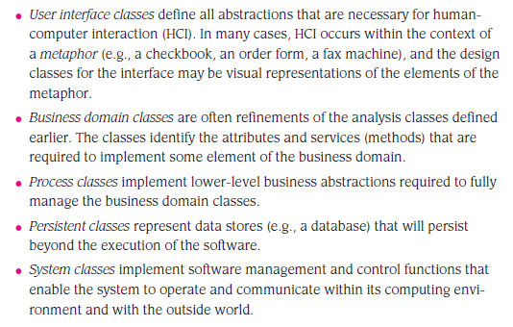
Design Classes
These slides are designed to accompany Software Engineering: A Practitioner’s Approach, 7/e (McGraw-Hill, 2009) Slides copyright 2009 by Roger Pressman.

Slide 39
Four characteristics of a well-formed design class:
Complete and sufficient. Complete encapsulation of all attributes and methods that can reasonably be expected
Sufficiency ensures that the design class contains only those methods that are sufficient to achieve the intent of the class, no more and no less.
Primitiveness. Methods associated with a design class should be focused on accomplishing one service for the class. Once the service has been implemented with a method, the class should not provide another way to accomplish the same thing
High Cohesion
Low coupling
These slides are designed to accompany Software Engineering: A Practitioner’s Approach, 7/e (McGraw-Hill, 2009) Slides copyright 2009 by Roger Pressman.

Slide 40
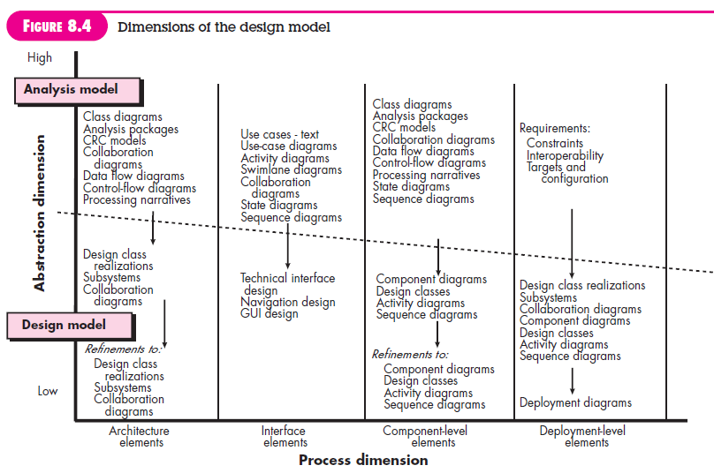
These slides are designed to accompany Software Engineering: A Practitioner’s Approach, 7/e (McGraw-Hill, 2009) Slides copyright 2009 by Roger Pressman.

Slide 41
Design Model Elements
Data elements
E.g What information elements exist?
  Data model --> data structures
  Data model --> database architecture
Architectural elements
E.g. Floor plan of house
  Application domain
  Analysis classes, their relationships, collaborations and behaviors are transformed into design realizations
  Patterns and “styles” (Chapters 9 and 12)
Interface elements
E.g. How doors, windows etc will look like
  the user interface (UI)
  external interfaces to other systems, devices, networks or other producers or consumers of information
  internal interfaces between various design components.
These slides are designed to accompany Software Engineering: A Practitioner’s Approach, 7/e (McGraw-Hill, 2009) Slides copyright 2009 by Roger Pressman.

Slide 42
Component elements
E.g. Set of detailed drawings, (and specifications) for each room in a house, i.e. wiring, switches, etc.
Deployment elements
These slides are designed to accompany Software Engineering: A Practitioner’s Approach, 7/e (McGraw-Hill, 2009) Slides copyright 2009 by Roger Pressman.

Slide 43
Architectural Elements
The architectural model [Sha96] is derived from three sources:
  information about the application domain for the software to be built;
  specific requirements model elements such as data flow diagrams or analysis classes, their relationships and collaborations for the problem at hand, and
  the availability of architectural patterns (Chapter 12) and styles (Chapter 9).
These slides are designed to accompany Software Engineering: A Practitioner’s Approach, 7/e (McGraw-Hill, 2009) Slides copyright 2009 by Roger Pressman.

Slide 44
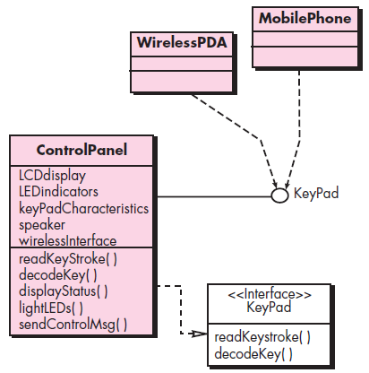
Interface Elements
These slides are designed to accompany Software Engineering: A Practitioner’s Approach, 7/e (McGraw-Hill, 2009) Slides copyright 2009 by Roger Pressman.

Slide 45
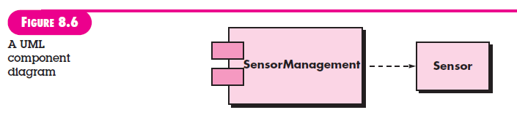
Component Elements
These slides are designed to accompany Software Engineering: A Practitioner’s Approach, 7/e (McGraw-Hill, 2009) Slides copyright 2009 by Roger Pressman.

Slide 46
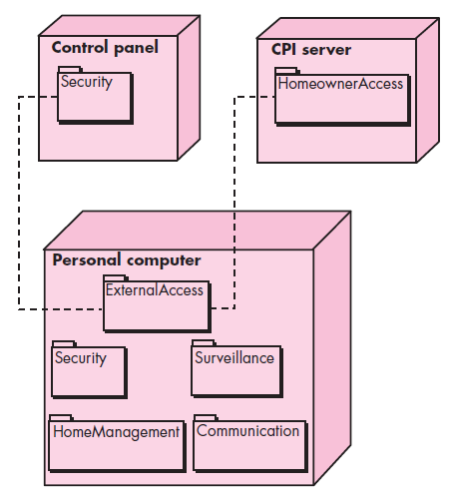
Deployment Elements
Defines how software functionality and subsystems will be allocated within the physical computing environment that will support the software
These slides are designed to accompany Software Engineering: A Practitioner’s Approach, 7/e (McGraw-Hill, 2009) Slides copyright 2009 by Roger Pressman.

